Slide 1
Project Plan
Group: Haotian Cheng & Yang Hu

Slide 2
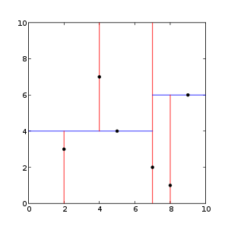
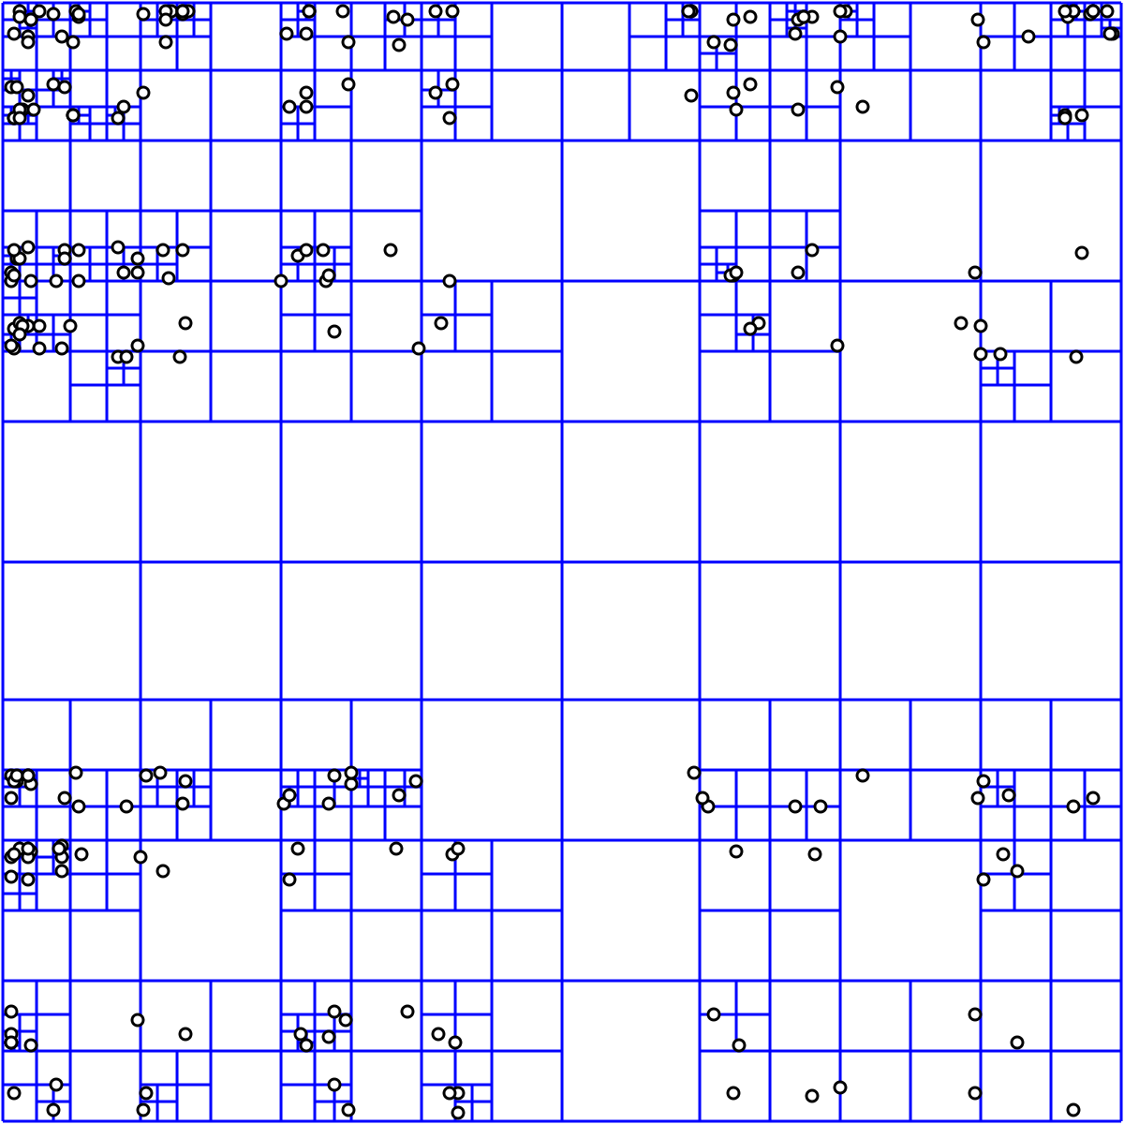
What is this project?
Nearest State/County Finder--------project #1
Use 2 different data structure to implement
K-D tree
Quad tree
Compare the two and give Pros and Cons
Language: Java

